Slide 1
CSE231 – Digital Logic Design
Standard Forms for
Boolean Expressions

Slide 2
Standard Forms for
Boolean Expressions
Sum-of-Products (SOP)
  Derived from the Truth table for a function by considering those rows for which F = 1.
  The logical sum (OR) of product (AND) terms.
  Realized using an AND-OR circuit.
Product-of-Sums (POS)
  Derived from the Truth table for a function by considering those rows for which F = 0.
  The logical product (AND) of sum (OR) terms.
  Realized using an OR-AND circuit.

Slide 3
In Mathematical Terms
Disjunctive Normal Form (DNF)
  Literals within each term are ANDed
  Terms are Ored
  Analogous to Sum-of-Products (SOP)
Conjunctive Normal Form (CNF)
  Literals within each term are Ored
  Terms are ANDed
  Analogous to Product-of-Sums (POS)

Slide 4
Sum-of-Products (SOP)

Slide 5
Minterms
A minterm, for a function of n variables, is a product term in which each of the n variables appears once.
Each variable in the minterm may appear in its complemented or uncomplemented form.
For a given row in the Truth table, the corresponding minterm is formed by
  Including variable x_{i}, if x_{i} = 1
  Including the complement of x_{i}, if x_{i} = 0
For all n variables
in the function F.

Slide 6




Minterms

Slide 7
Sum-of-Products
Any function F can be represented by a sum of minterms, where each minterm is ANDed with the corresponding value of the output for F.
  F = Σ (m_{i} . f_{i})
    where m_{i} is a minterm
    and f_{i} is the corresponding functional output
  Only the minterms for which f_{i} = 1 appear in the expression for function F.
  F = Σ (m_{i}) = Σ m(i)
Denotes the logical
sum operation
shorthand notation

Slide 8
Sum-of-Products
The Canonical Sum-of-Products for function F is the Sum-of-Products expression in which each product term is a minterm.
  The expression is unique
  However, it is not necessarily the lowest-cost
Synthesis process
  Determine the Canonical Sum-of-Products
  Use Boolean Algebra (and K-maps) to find an optimal, functionally equivalent, expression.

Slide 9
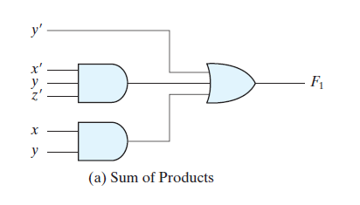
Sum-of-Products
AND
sum
Y' + X'YZ' + XY
X.Y
OR
AND
product term
Product Term = Logical ANDing of literals
Sum = Logical ORing of product terms

Slide 10
Sum-of-Products
Use the Distributive Laws to multiply out a Boolean expression.
Results in the Sum-of-Products (SOP) form.
F = (A + B).(C + D).(E)
F = (A.C + A.D + B.C + B.D).(E)
F = A.C.E + A.D.E + B.C.E + B.D.E
Product terms are
of single variables
not in SOP form
H = A.B.(C + D) + ABE

Slide 11
Product-of-Sums (POS)

Slide 12
Maxterms
A Maxterm, for a function of n variables, is a sum term in which each of the n variables appears once.
Each variable in the Maxterm may appear in its complemented or uncomplemented form.
For a given row in the Truth table, the corresponding Maxterm is formed by
  Including the variable x_{i}, if x_{i} = 0
  Including the complement of x_{i}, if x_{i} = 1

Slide 13
Maxterms

Slide 14
Product-of-Sums
Any function F can be represented by a product of Maxterms, where each Maxterm is ANDed with the complement of the corresponding value of the output for F.
  F = Π (M_{i} . f '_{i})
    where M_{i} is a Maxterm
    and f '_{i} is the complement of the corresponding functional output
  Only the Maxterms for which f_{i} = 0 appear in the expression for function F.
  F = Π (M_{i}) = Π M(i)
Denotes the logical
product operation
shorthand notation

Slide 15
Product-of-Sums
The Canonical Product-of-Sums for function F is the Product-of-Sums expression in which each sum term is a Maxterm.
  The expression is unique
  However, it is not necessarily the lowest-cost
Synthesis process
  Determine the Canonical Product-of-Sums
  Use Boolean Algebra (and K-maps) to find an optimal, functionally equivalent, expression.

Slide 16
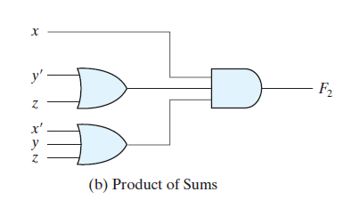
Product-of-Sums
OR
product term
X.(Y' + Z).(X' + Y + Z)
X' + Y + Z
AND
sum term
OR
Sum Term = Logical ORing of variables
Product = Logical ANDing of sum terms

Slide 17
Product-of-Sums
Use the Distributive Laws to factor a Boolean expression.
Results in the Product-of-Sums (POS) form.
F = V.W.Y + V.W.Z + V.X.Y + V.X.Z
F = (V).(W.Y + W.Z + X.Y + X.Z)
F = (V).(W + X).(Y + Z)
Sum terms are
of single variables
not in POS form
H = (A+B).(C+D+E) + CE

Slide 18
SOP and POS
Any function F may be implemented as either a Sum-of-Products (SOP) expression or a Product-of-Sums (POS) expression.
Both forms of the function F can be realized using logic gates that implement the basic logic operations.
However, the two logic circuits realized for the function F do not necessarily have the same cost.
Objective: minimize the cost of the designed circuit
  Compare the cost of the SOP realization with that of the POS realization

Slide 19
Converting between SOP and POS
The sum-of-products (SOP) form of a Boolean expression can be converted to its corresponding product-of-sums (POS) form by factoring the Boolean expression.
The product-of-sums (POS) form of a Boolean expression can be converted to its corresponding sum-of-products (SOP) form by multiplying out the Boolean expression.

Slide 20
Dual
The dual of a Boolean expression is formed by changing AND to OR, OR to AND, 0 to 1, and 1 to 0.
Alternately, it can be determined by complementing the entire Boolean expression, and then complementing each of the literals.
The SOP and POS are duals of one another.

Slide 21
Logic Circuit Implementations

Slide 22
Student Exercise:
Draw the AND-OR circuits for the following
Sum-of-Products (SOP) expressions:
1. F₁ = A'B + AC' + B'C
2. F₂ = ABD + BCD' + AB'C' + B'CD

Slide 23
Student Exercise:
Draw the OR-AND circuits for the following
Product-of-Sums (POS) expressions:
1. F₁ = (A+B').(A'+C).(B+C')
2. F₂ = (A+B+D).(B'+C+D').(A'+B+C).(B+C'+D)

Slide 24
Summary of Logic Functions

Slide 25
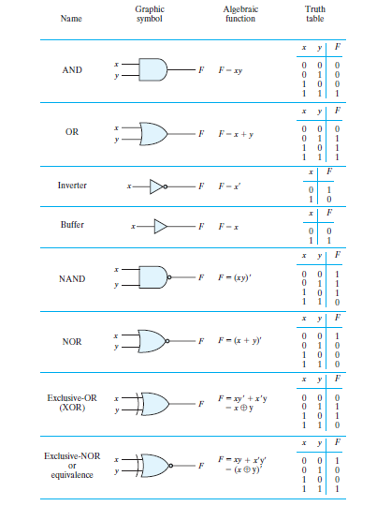

Slide 26
Representing Logic Levels
(using voltages)

Slide 27
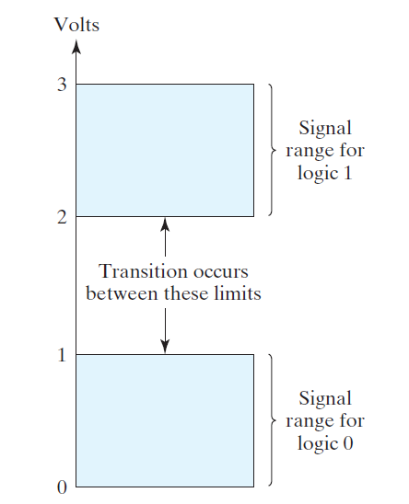
Signal Levels and Logic Levels

Slide 28
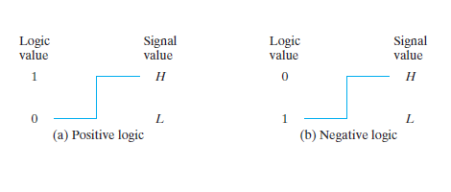
Signal Levels and Logic Levels
ECE 301 - Digital Electronics

Slide 29
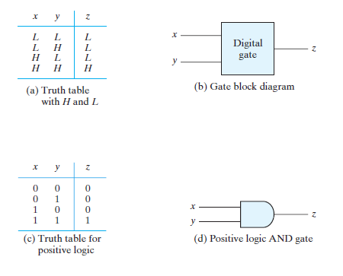
Signal Levels in Logic Gates

